Slide 1
Custom Functions for Excel

Slide 2




Sia Ghassemi
Cloud architect
DevSecurity Expert
Microsoft Azure MVP
Founder of sia consulting
Running DevTalks.de
Next DevTalks 1.12. 9pm: Holger Schwichtenberg

Slide 3
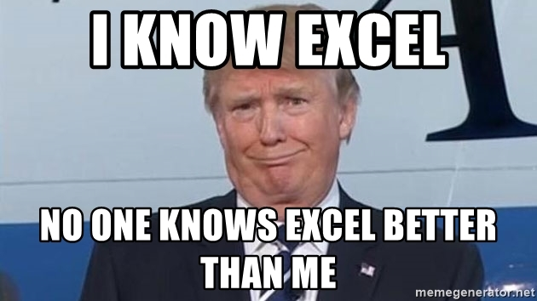
What this talk is about

Slide 4
So how are you doing this today? We do have a Excel Spreadsheet for that!
z

Slide 5

Ok, cool we will replace that by a beautiful app. It will do all the things you are doing today and it will all work seamlessly with your current system!
z

Slide 6
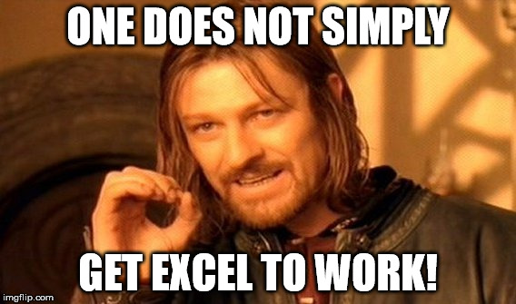

Slide 7
Replacing Excel is not easy!
The new App won’t have the full power of Excel
It takes time to transition to the new system
It will take a lot of time to get to the same performance with the new app

Slide 8
But we need to replace Excel!
Excel Spreadsheets are hard to maintain
Spreadsheets don’t scale well
Spreadsheets need to be imported
VBA is a pain ;)

Slide 9
There is a silver lining!
Custom Functions in Excel (preview)
Part of new Add-In system using JavaScript (Office 2016+; Excel, Word, Powerpoint, Outlook)
Deployable individually and Tenant-wide

Slide 10
Azure Functions
Serverless
Cloud-Only
Event-Driven
Perfect Scalability
Very good fit for Microservices

Slide 11
Azure Cloud Computing
IaaS
PaaS
Infrastructure
VMs
Manage everything yourself
Platform
Shared Platform
Platform manages everything for you
Manage Application Runtime and Application

Slide 12
Azure Cloud Computing
PaaS
FaaS
Platform
Shared Platform
Platform manages everything for you
Manage Application Runtime and Application
Function
Shared Instance
Instance manages everything for you
Function Host manages Runtime and Application
You manage Function only

Slide 13
Azure Functions
DB
Web-Server
Feature
Messaging
Monitoring

Slide 14
Azure Functions
DB
Web-Server
Feature
Messaging
Monitoring

Slide 15

Azure Functions
In Bindings*
Trigger
Out Bindings*

Slide 16

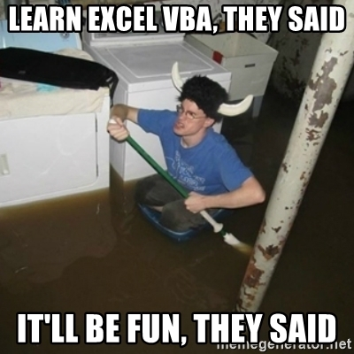
Custom Functions for Excel

Slide 17
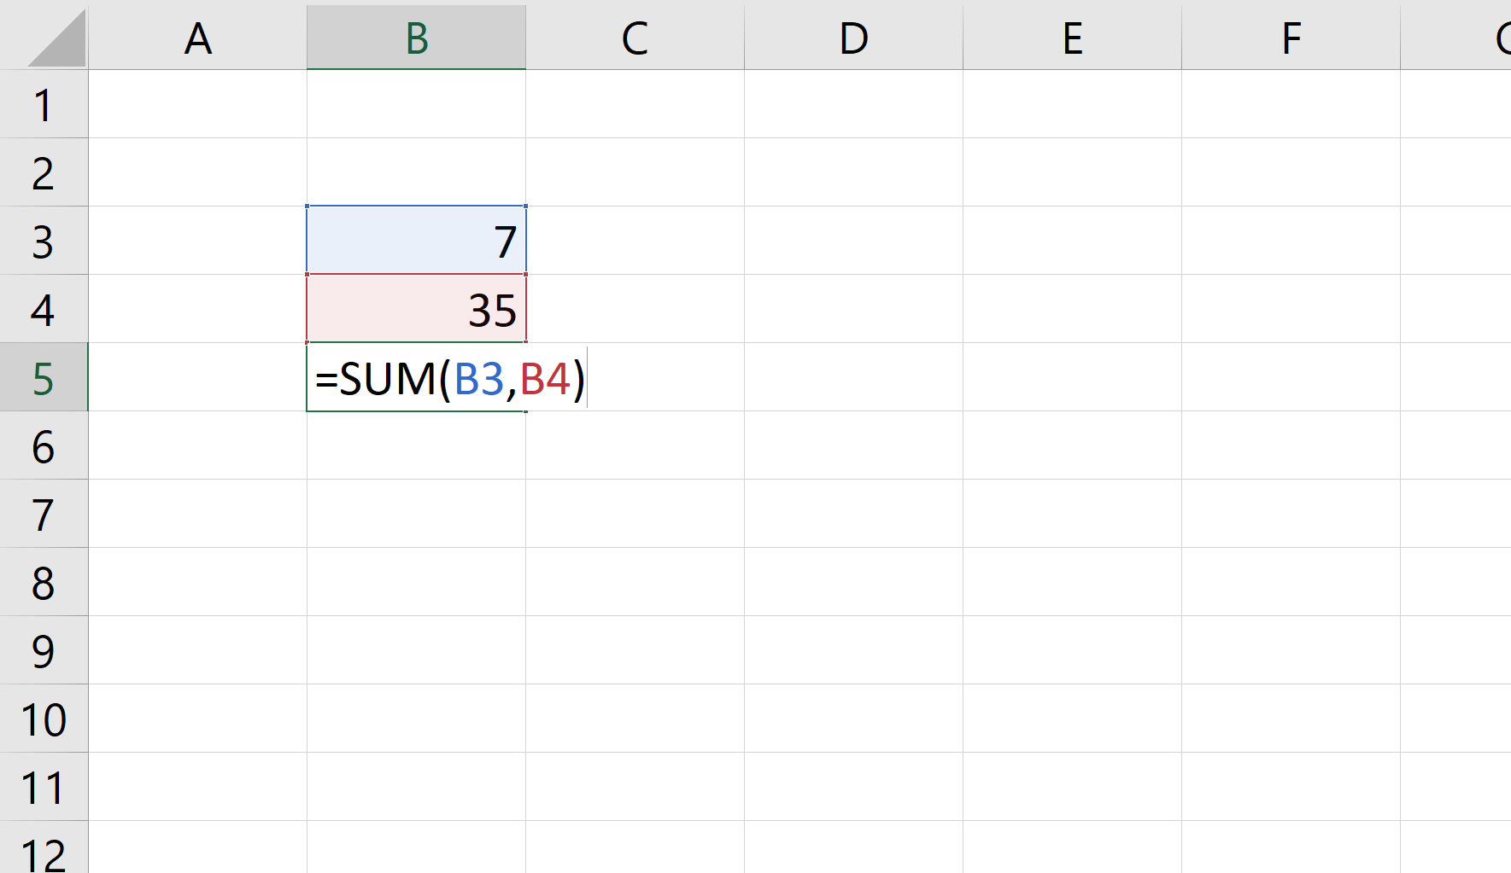

Slide 18
Custom Functions
run across all Excel platforms
run fast
look and feel like native Excel functions
shipped by developers as part of an add-in
make web service calls (if desired)
run offline if they don’t depend on the web*
run even when the workbook is unattended (very early preview)

Slide 19
Custom Functions
Good bye VBA
Hello JavaScript

Slide 20
Custom Functions
VBA
Custom Functions
VB
Runs only on Windows
You need VBA developers
Limited to Macros
JavaScript (TypeScript, F# Dart etc)
Runs everywhere
Grab a Frontend-Dev
Full-feature-set (UI, Control, etc.)

Slide 21
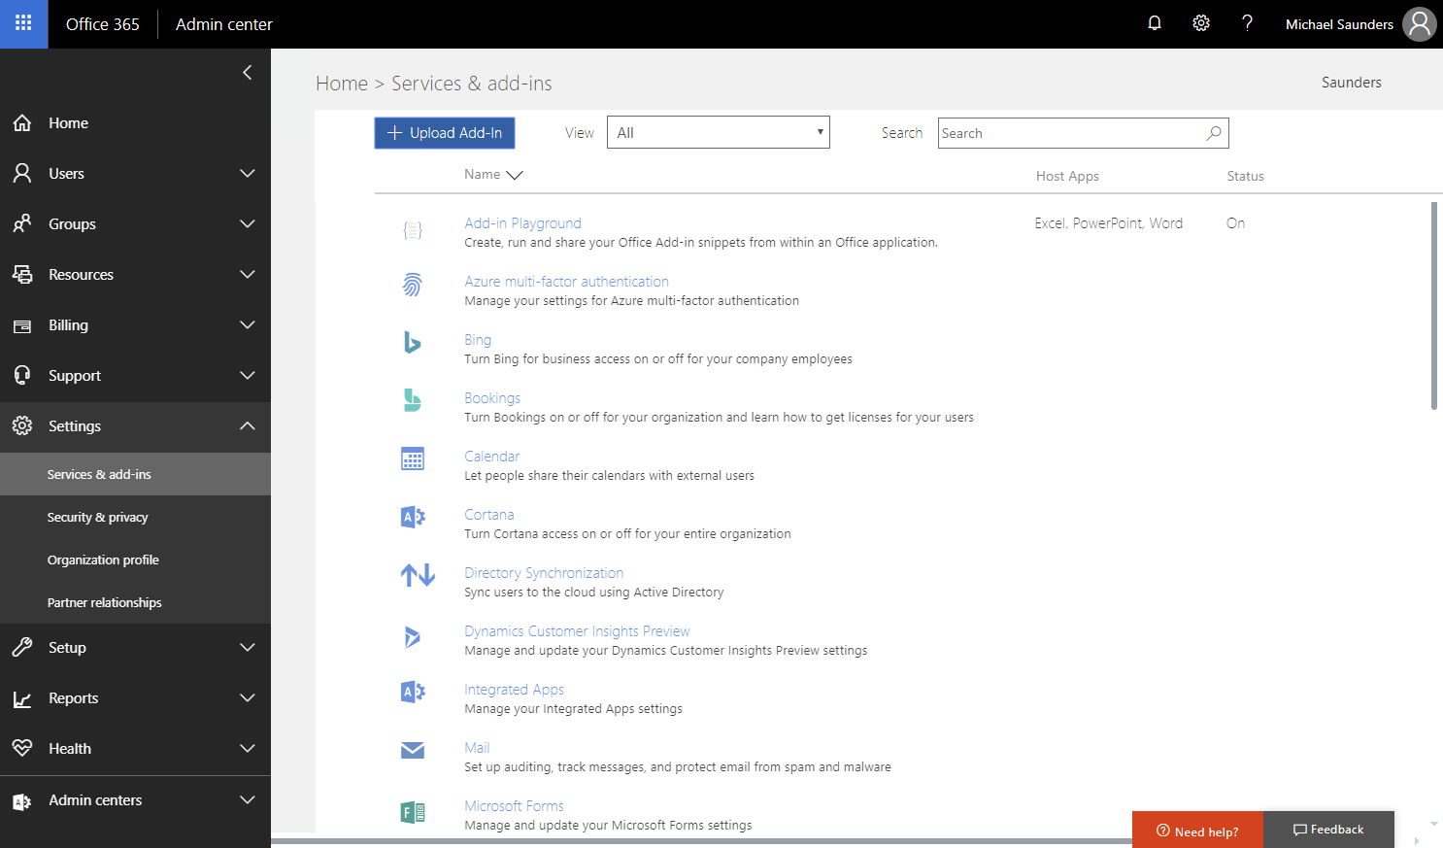
Admin configures access in O365 portal

Slide 22
Where should the code run for custom functions?
Run code on the client
Cheap
Works offline
No network delay
Run code on the server
Scalable for heavy processing and memory needs
Doesn’t depend on a person
Math problems
=ISPRIME
Public Web Data
=BITCOIN
Unattended
=CITYFROMPHONE
Machine Learning
=FRAUDPROBABILITY
JavaScript custom functions
Azure Machine Learning functions

Slide 23
Demo
Custom Functions

Slide 24
Performance
Custom Functions

Slide 25
Details
Intel Xeon E5-1680 v4 @ 3.40GHz (8 cores)
Measured total time for 1000 functions
Median of 20 trials
ChakraCore runtimes are preloaded
Test Scenarios
Calculate the mortgage payment for a given principal, period, and rate
Find the 1000th prime number

Slide 26
Azure Functions Demo
Custom Functions

Slide 27
AWS Lambda Demo
Custom Functions

Slide 28
Custom Functions possible futures
Machine Learning
Push updates
Workflows
Run everywhere

Slide 29
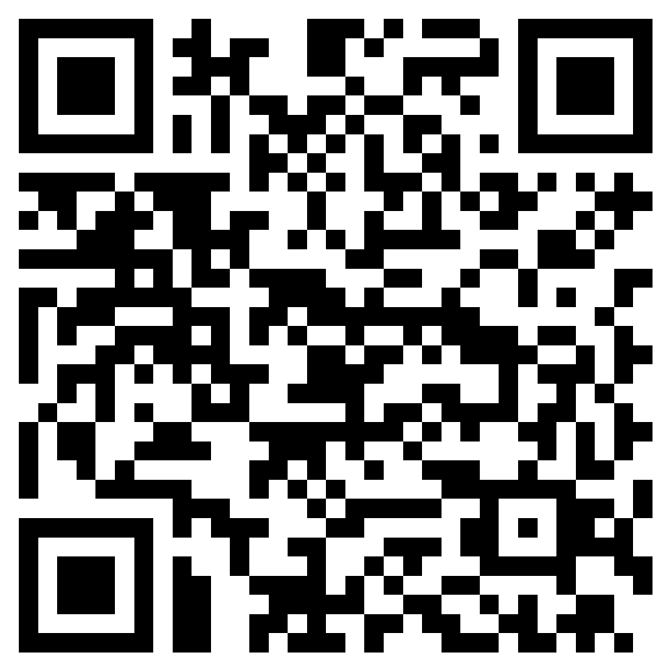
Resources
https://docs.microsoft.com/en-us/office/dev/add-ins/reference/javascript-api-for-office
https://github.com/officedev/office-js/
https://docs.microsoft.com/en-us/javascript/api/custom-functions-runtime?view=excel-js-preview
https://docs.microsoft.com/en-us/office/dev/add-ins/excel/custom-functions-overview
https://docs.microsoft.com/en-us/office/dev/add-ins/excel/
https://github.com/dersia/ExcelSignalRSample
https://github.com/dersia/m365bootcamp

Slide 30
Q & A

Slide 31
Thank you!

